Slide 1
Auto Insurance Claim Fraud Predictors
Mary Donovan Martello
Data Science, Bellevue University
DSC530, Data Exploration and Analysis
May 28, 2020

Slide 2
Introduction
Automobile insurance fraud results in upward of $7.7 billion a year in losses. Therefore, automobile insurance claim fraud detection and prevention are important endeavors for businesses. Identifying factors that indicate fraudulent claims will assist in fraud detection and prevention.
The data set has a variable that indicates whether fraud was reported on each observation (i.e., each auto insurance claim instance). This variable is either Y or N. I created subsets of the dataframe based on the fraud_reported variable.

Slide 3
Statistical Questions
What factors in auto insurance claims indicate that the claims are fraudulent claims?
Which combination of factors about the insured, auto policy and alleged damage incident indicate potential fraudulent claims?
Are the values of variables in observations in which fraud was reported differ statistically from the values of variables in observation in which no fraud was reported?

Slide 4
Key Variables Used During Analysis
Total Claim Amount – Total amount of auto insurance claim. It combines amounts for vehicle claims, injury claims and property claims.
Umbrella Limit – Limit of umbrella insurance coverage.
Months Before Incident – created variable indicating number of months between the policy bind data and the date of the claim incident.
Witnesses – Number of witnesses to the claim incident.
Deductible – Auto insurance policy deductible amount.
Incident Severity – severity of the claim incident: Major Damage, Minor Damage, Trivial Damage or Total Loss

Slide 5
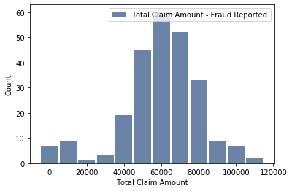
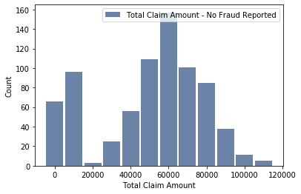
Total Claims Histograms
Total Claims – Fraud Reported
Total Claims – No Fraud Reported
Proportion of cases at $10,000: fraud reported cases is 30% less than fraud not reported cases.
Proportion of cases at $70,000: fraud reported cases is 50% higher than fraud not reported cases.

Slide 6
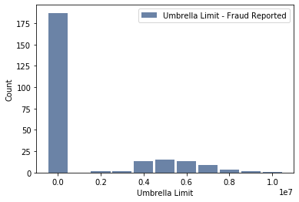
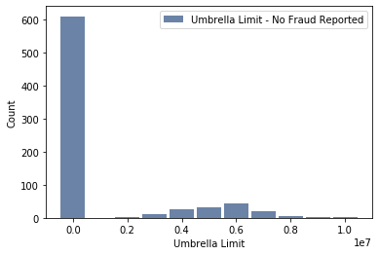
Umbrella Limit Histograms
Umbrella Limit – Fraud Reported
Umbrella Limit – No Fraud Reported
Fraud reported cases: lower at zero limit and higher at $4 - $5 million.
Fraud not reported cases: higher at zero limit and lower at $4 - $5 million.

Slide 7
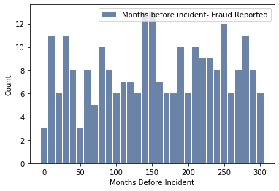
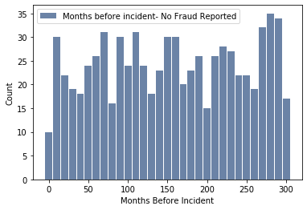
Months Before Incident Histograms
Months Before Incident – Fraud Reported
Months Before Incident – No Fraud Reported
Fraud reported cases at 50 months is proportionally lower than fraud not reported cases.
Fraud reported cases at 250 months is proportionally higher than fraud not reported cases.

Slide 8
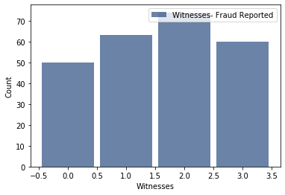
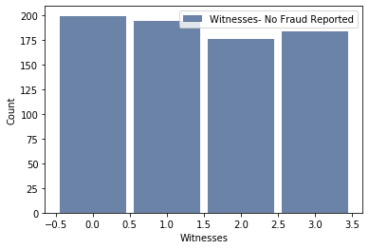
Witnesses Histograms
Witnesses – Fraud Reported
Witnesses – No Fraud Reported
Witness counts increase from 0 to 2 in fraud reported cases, but decreases / remains flat for fraud not reported cases.

Slide 9
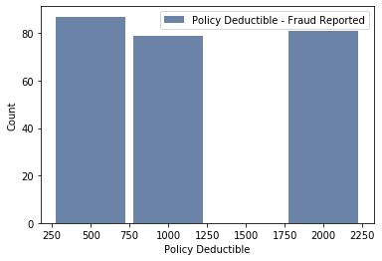
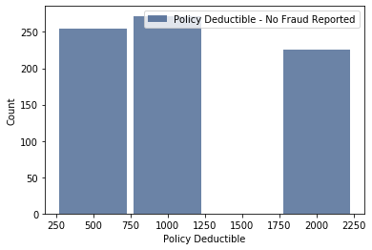
Deductibles Histograms
Deductibles – Fraud Reported
Deductibles – No Fraud Reported
Fraud reported cases have higher counts at $500 and $2,000 deductible amounts but fraud not reported cases have higher counts at $1,000 deductible amounts.

Slide 10
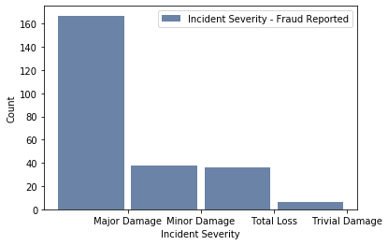
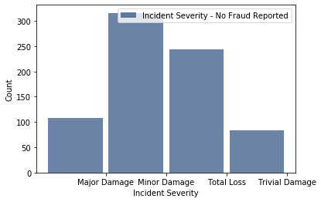
Incident Severity Histograms
Incident Severity – Fraud Reported
Incident Severity – No Fraud Reported
68% of fraud reported cases claimed Major Damage but only 14% of fraud not reported cases claimed Major Damage.

Slide 11
Total Claim Amount – Descriptive Statistics
 | Fraud Reported Cases | Fraud Not Reported Cases
Mean | 60,300 | 50,230
Mode | N/A | N/A
25% | 51,900 | 34,650
50% | 61,290 | 56,475
75% | 72,665 | 69,480
Skew | -0.820915 | -0.469569
Kurtosis | 1.39238 | -0.789692
Fraud reported cases have higher means and quartiles at every checkpoint.

Slide 12
Umbrella Limit – Descriptive Statistics
 | Fraud Reported Cases | Fraud Not Reported Cases
Mean | 1,340,000 | 1,030,000
Mode | 0 | 0
25% | 0 | 0
50% | 0 | 0
75% | 0 | 0
Skew | 1.56778 | -0.469569
Kurtosis | 1.03125 | -0.789692
Mean, mode and quartiles are not helpful because of so many zero counts.

Slide 13
Months Before Incident – Descriptive Statistics
 | Fraud Reported Cases | Fraud Not Reported Cases
Mean | 155.8 | 155.5
Mode | 62.4 | N/A
25% | 83.0 | 80.4
50% | 152.4 | 154.8
75% | 233.4 | 232.1
Skew | -0.103498 | -0.0340399
Kurtosis | -1.18728 | -1.20685
Nothing noteworthy.

Slide 14
Witnesses – Descriptive Statistics
 | Fraud Reported Cases | Fraud Not Reported Cases
Mean | 1.6 | 1.5
Mode | 2 | 0
25% | 1 | 0
50% | 2 | 1
75% | 2 | 2
Skew | -0.11723 | 0.0646493
Kurtosis | -1.21972 | -1.37144
Fraud reported cases have higher means and quartiles at every checkpoint.

Slide 15
Deductible Amount – Descriptive Statistics
 | Fraud Reported Cases | Fraud Not Reported Cases
Mean | 1,152 | 1,132
Mode | 500 | 1,000
25% | 500 | 500
50% | 1,000 | 1,000
75% | 2,000 | 2,000
Skew | 0.414332 | 0.498183
Kurtosis | -1.49377 | -1.33809
Fraud reported cases have a lower deductible amount mode, but no significant difference from fraud not reported.
.

Slide 16
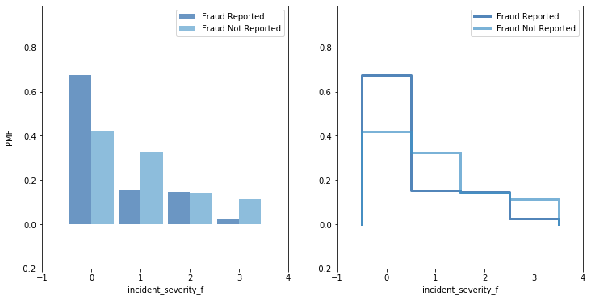
Incident Severity PMF
Incident Severity – PMF Bar Graph
Comparison of Incident Severity for fraud reported cases vs Incident Severity for fraud not reported cases. The probability of factor 0 (Major Damage) is significantly higher for fraud reported cases. Accordingly, the probability of other values for fraud not reported are much more probable.

Slide 17
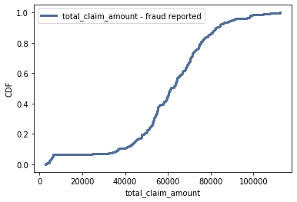
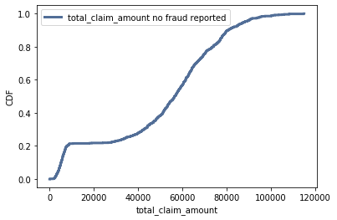
Total Claims Cumulative Distribution Functions
Total Claims – Fraud Reported
Total Claims – No Fraud Reported
The CDFs for both fraud reported cases and fraud not reported cases show total claim amounts to be closely like a normal distribution. The CDF for fraud not reported cases increases more quickly than the CDF for fraud reported cases. This indicates that higher claim amounts are more likely for fraud reported cases.

Slide 18
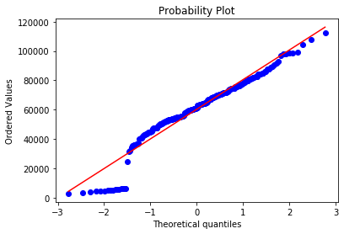
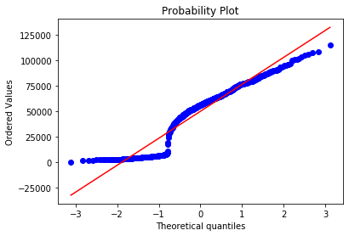
Total Claims Probability Plots
Total Claims – Fraud Reported
Total Claims – No Fraud Reported
Both claim amounts analytical normal distributions are a fairly reliable approximation, but it becomes less so as values get further from the mean. In particular, the lower claim amounts are not approximately normal.

Slide 19
Scatterplots and Correlation
The research question is essentially which variables indicate a fraudulent claim. However, the fraud reported variable is a binary variable and thus not illustrative by scatterplots. Point-biserial correlation is used when one of the variables is a discrete dichotomous variable and thus I used point-biserial correlation for the fraud reported variable.
Pearson’s correlation between two continuous variables may be helpful to answer the research question because the correlation between two variables may influence a fraudulent claim. Scatterplots are illustrative for the relationship between two continuous variables.

Slide 20
Scatterplots and Correlation
Fraud Reported vs: | Correlation | p-value
Total Claim Amount | -0.1648 | 1.6272
Umbrella Limit | -0.0581 | 0.0663
Months Before Incident | -0.0015 | 0.9633
Witnesses | -0.0493 | 0.1197
Deductible | -0.0142 | 0.6532
Point-biserial correlation is used for correlation between the binary fraud reported variable and continuous variables.
None of the correlations with the fraud reported variable is strong. However, the p-value for umbrella limit appears significant.

Slide 21
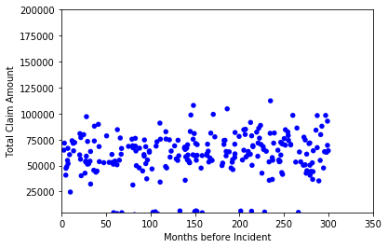
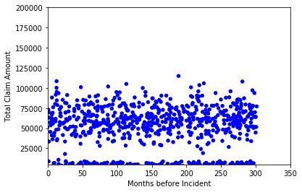
Scatterplots and Correlation: Total Claims and Months Before Incident
Fraud Reported Correlation: 0.13269
No Fraud Reported Correlation: -0.03567
None of the continuous variables have strong correlation or linear relationships. It is illustrative that the fraud reported correlation for Months Before Incident and Total Claims is positive but the fraud not reported correlation is negative.

Slide 22
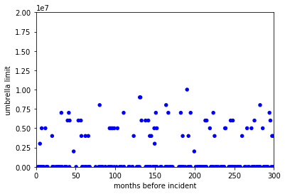
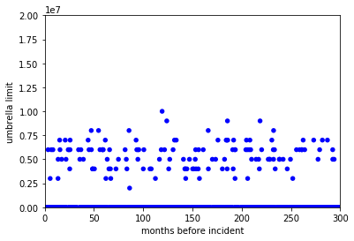
Scatterplots and Correlation: Umbrella Limit and Months Before Incident
Fraud Reported Correlation: 0.00635
No Fraud Reported Correlation: -0.06455
None of the continuous variables have strong correlation or linear relationships. It is illustrative that the fraud reported correlation for Months Before Incident and Umbrella Limit is positive but the fraud not reported correlation is negative.

Slide 23
Hypothesis Testing
Hypothesis: There is no difference in the means of variables in the fraud reported subset and the same variables in the fraud not reported subset.
 | p-value
Total Claim Amount | 0.000
Umbrella Limit | 0.076
Months Before Incident | 0.958
Witnesses | 0.130
Deductible | 0.662
For Total Claim Amount, the p-value of 0.000 is significant and thus we reject the null hypothesis that there is no difference in the means of Total Claim Amount in the fraud reported subset and the fraud not reported subset.
The p-values of the other variables are all > 0.05, which means it is plausible that the observed difference in means are just the result of random sampling.

Slide 24
Logistic Regression
My outcome variable is a binary categorical variable and therefore I am using logistic regression to try to determine explanatory variables to predict the fraud reported variable. Note: I am able to use the categorical variables in the regression model as I converted them to numeric data types.
I ran the logistic regression model on all the variable to look for variables with best pseudo r-squared results because they are an indicator of fit.
However, the models with just the variables with the highest pseudo r-squared values did not return the best results.
The model with the best results was the model with all the permissible variables including (excluding those variables causing multicollinearity).
Conclusion is that none of the variables separately or in small combinations are as predictive as including all of the variables.

Slide 25
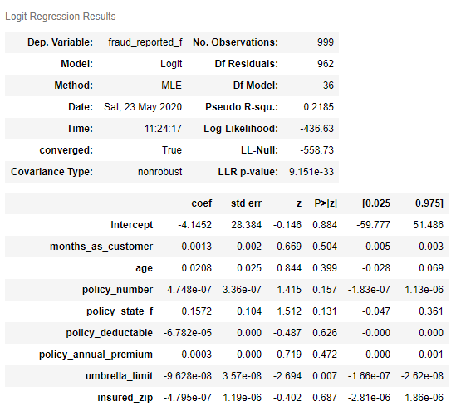
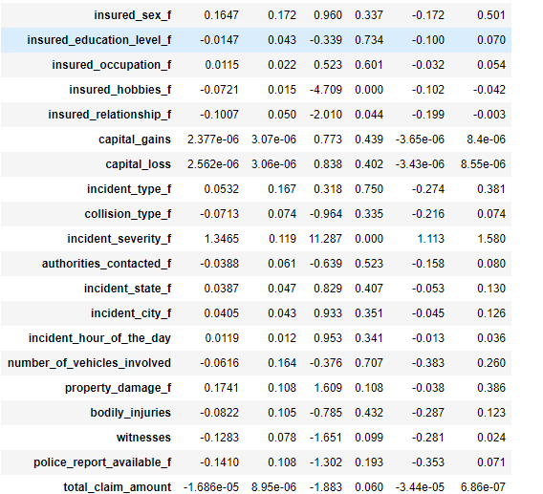
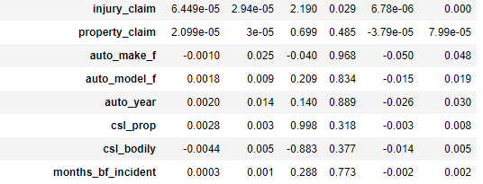

Slide 26
Conclusion
I was hoping that the analysis would show certain variables were strongly indicative of predicting fraudulent auto insurance claims . Some of the individual variables seem more significant than others, such as incident_severity, total_claim_amount, umbrella_limit, and witnesses. However, none of these show very strong correlations or indications of influence in the predictive models.

